Slide 1
查询规模估算 Cardinality Estimation
2022/11/3

Slide 2
查询规模定义
查询规模 (Cardinality)
𝒬: SELECT * FROM 𝑆𝑡𝑢𝑑𝑒𝑛𝑡 WHERE 𝑎𝑔𝑒 > 15 AND 𝑔𝑒𝑛𝑑𝑒𝑟 = ‘Male’;
Card(Q) = 4
实验目标：给定一条SQL查询，
预测符合该查询的结果数目

Slide 3
Why Cardinality Estimation
2014
“The root of all evil, the Achilles Heel of query optimization, is the estimation of the size of intermediate results, known as cardinalities.”
2015
“We have also shown that relational database systems produce large estimation errors that quickly grow as the number of joins increases, and that these errors are usually the reason for bad plans.”
2018
-
2021
Multiple research groups consistently working on learned selectivity estimators

Slide 4
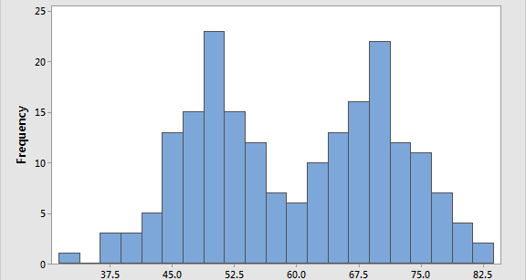
传统规模估算方法
Histograms
Sampling

Slide 5
When Traditional Methods Fail
SELECT * FROM title WHERE production_year > 1995
SELECT * FROM title WHERE production_year > 2010
SELECT * FROM title WHERE production_year > 2018
SELECT * FROM title AS t
WHERE t.production_year > 2005 AND revenues >100,000,000
SELECT * FROM title AS t, movie_info_idx AS mi_idx
WHERE t.production_year > 2005 AND mi_idx.info < 8.5
AND t.id = mi_idx.movie_id
非均匀分布
属性相关
JOIN

Slide 6
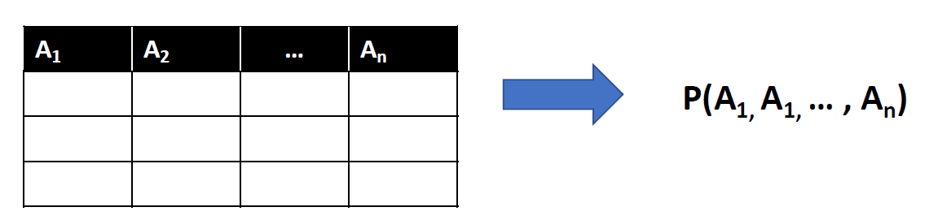
How Learned Cardinality Estimators Work
Methodology 1: Query-driven
Key Idea: Model as a Regression problem
Query Feature Vector Selectivity
Methodology 2: Data-driven
Key Idea: Model as a Joint Distribution Estimation problem
Feature Engineering
ML Models

Slide 7
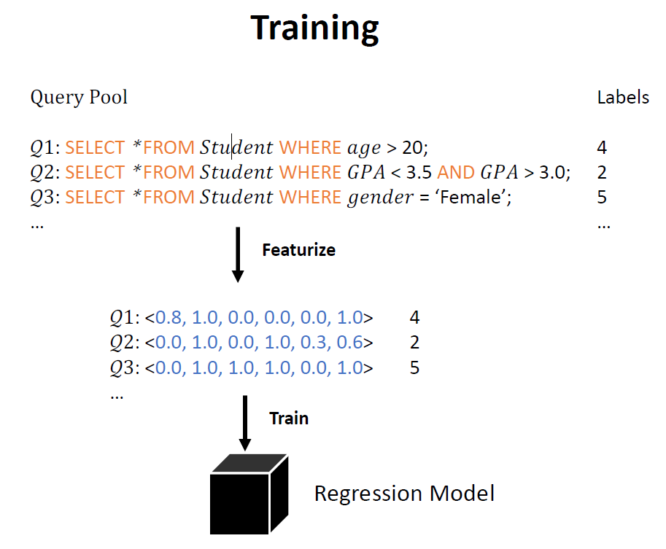
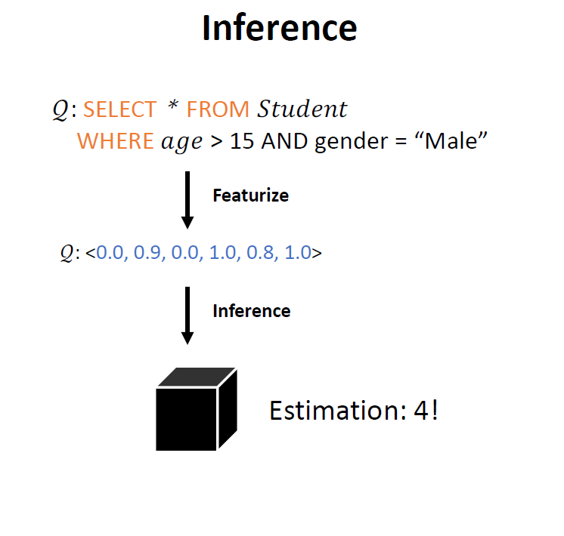
Methodology: Query-Driven
Jiannan Wang, Machine Learning for Data Intensive Systems

Slide 8
任务说明
根据SQL查询语句，预测查询规模
SQL类型
数值型数据（范围查询与等值查询）
最多涉及两表连接
提供查询计划（可选）
提供10000条训练集，需要预测2000条测试集的结果

Slide 9
数据解释
Training_data.csv
Testing_data.csv
SELECT * FROM title t, movie_keyword mk WHERE mk.keyword_id<1029 AND t.id=mk.movie_id
title t,movie_keyword mk # t.id=mk.movie_id # mk.keyword_id,<,1029 #1038381
SELECT * FROM title t WHERE t.production_year >2005
title t # # t.production_year,>,2005

Slide 10
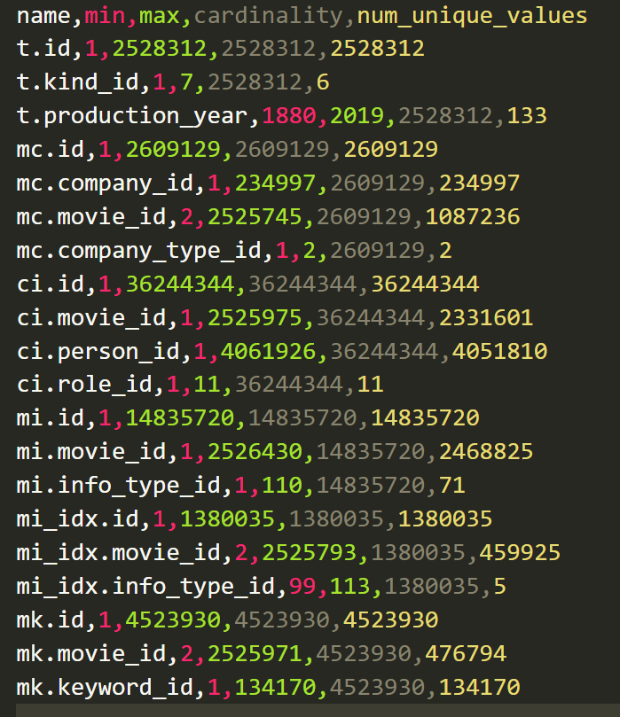
Column_min_max_vals.csv
每张表的最小值、最大值、元组数目、不重复记录数目

Slide 11
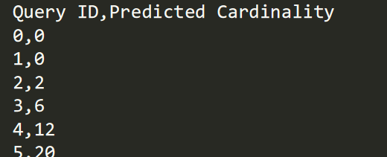
Submission sample

Slide 12
A naïve implementation
共有N个表，d个属性
lb: lower bound ub: upper bound
2*d维向量 [lb₁,ub₁,lb₂,ub₂,…….lb_{d},ub_{d}]
One-hot encoding for join
SELECT * FROM title t, movie_keyword mk WHERE t.production_year >2005 AND mk.keyword_id<1029 AND t.id=mk.movie_id
[0, 0, 2005, 0,……,0, 0, 0, 1029, 0, 0]
[0, 1, 0, ……, 0]
t.production_year
mk.keyword_id
t.id=mk.movie_id

Slide 13
Representative Works
Query-based
• MSCN [Kipf, A et all. CIDR 19]
Neural Network + Sampling
• LW-XGB [Dutt, A et all. VLDB 19]
XGBoost+ Histogram
• LW-NN [Dutt, A et all. VLDB 19]
Neural Network + Histogram
• QuickSel [Yongjoo, P et all. SIGMOD 20]
Mixture Model
Data-based
• Naru [Yang, Z et all. VLDB 20]
Auto-regressive Model
• DeepDB [Hilprecht, B et all. VLDB 20]
Sum Product Network
• FLAT [Rong, Z et all. VLDB 2021]
Graphical Model

